Slide 1
04.11.2022 yil
Tajriba ishi №4
Mavzu: Texnik ob’ektlarga immitatsion modellarni yaratish va tahlil etish.
Ishning maqsadi: Talabalarning MatLAB bilan ishlash ko’nikmalarini oshirish va unda imitatsion modellarni amalga oshirish.

Slide 2

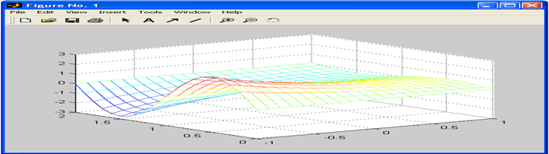
Uch o’lchovli grafikani yaratish
>> [X,Y]=meshgrid(-1:0.1:1,0:0.1:2);
>> Z=exp(-X).*sin(pi*Y);
>> mesh(X,Y,Z)

Slide 3
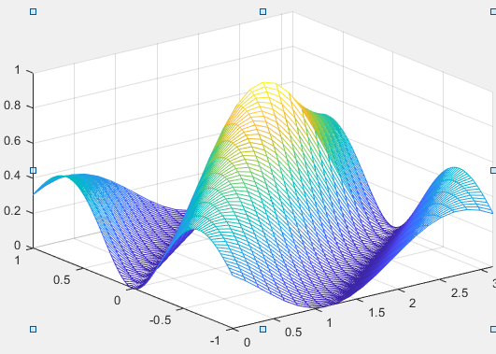
Uch o’lchovli grafikani yaratish
>> [X,Y]=meshgrid(0:pi/20:pi, -1:0.02:1);
>> Z=(sin(X-2*Y).^2).*exp(-abs(Y));
>> mesh(X,Y,Z)

Slide 5

>> x1=[-4*pi:pi/10:-pi];
>> y1=sin(x1);
>> x2=[-pi:pi/30:0];
>> y2=3*(x2/pi+1).^2;
>> x3=[0:0.02:5];
>> y3=3*exp(-x3);
>> plot(x1,y1,x2,y2,x3,y3)

